Slide 1

TURNING DEBT INTO HOPE:
ACTION TO END THE CLIMATE AND INEQUALITY EMERGENCIES
Matthew Martin
Act Church of Sweden Seminars
Uppsala/Stockholm
June 2026
  Executive Director,
  Development Finance International
  www.development-finance.org

Slide 2
THE WORST EVER GLOBAL DEBT CRISIS

Slide 3
WORST EVER GLOBAL DEBT CRISIS ?
Report submitted to the UN Secretary General today shows world now has definitely its worst ever debt crisis.
DFI “Debt Service Watch” database (based on IMF numbers) shows debt payments (“service”) as % of total budget revenue now much higher across the global South than ever have been before, and will continue to be this way for the next decade. The efforts countries make to collect more tax are being diverted to pay debt

Slide 4
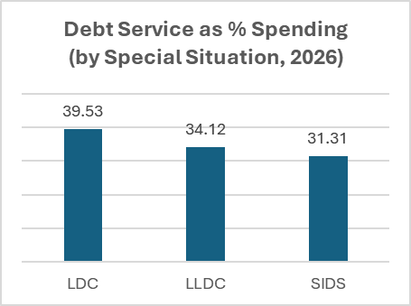
THE BREADTH OF THE CRISIS
In 2026 global South will pay US$8.8 trillion in debt service, of which US$1.3 billion from lower-income countries
All country groups across the global South affected: whether look at income, region or UN “special situation” – least developed, landlocked, SIDS
Worst affected are LICs and LMICs (UMICs not far behind); Africa, Latin America, Asia; and all special situation groups.
DEBT SERVICE AS % OF SPENDING FOR DIFFERENT GROUPS

Slide 5
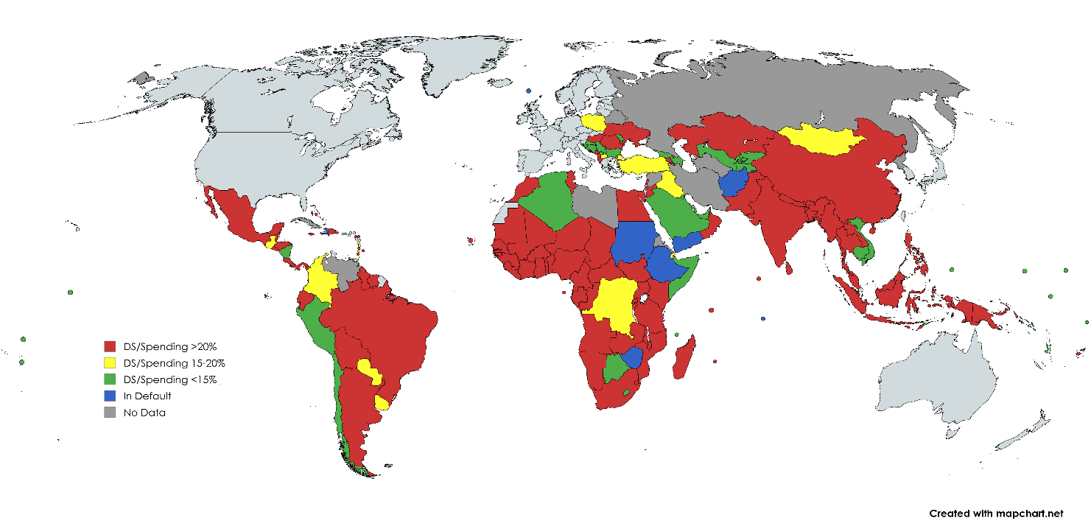
THE COUNTRIES AFFECTED
Map below shows 105 countries which have clearly unsustainable debt service burdens for next 10 years, service absorbing >15-20% of their spending

Slide 6
IMPACT ON SOCIAL/CLIMATE SPENDING
Debt payments are pushing aside spending on main social sectors vital to reduce inequality/poverty (education, health, social protection) and fight climate/environment/nature crisis
They average 3x education spending, 5x health, 12 times social protection and 100 times climate/nature spending !
Across all countries on average debt service is 20% more than total core social spending, and 10% more than total social + environmental spending

Slide 7
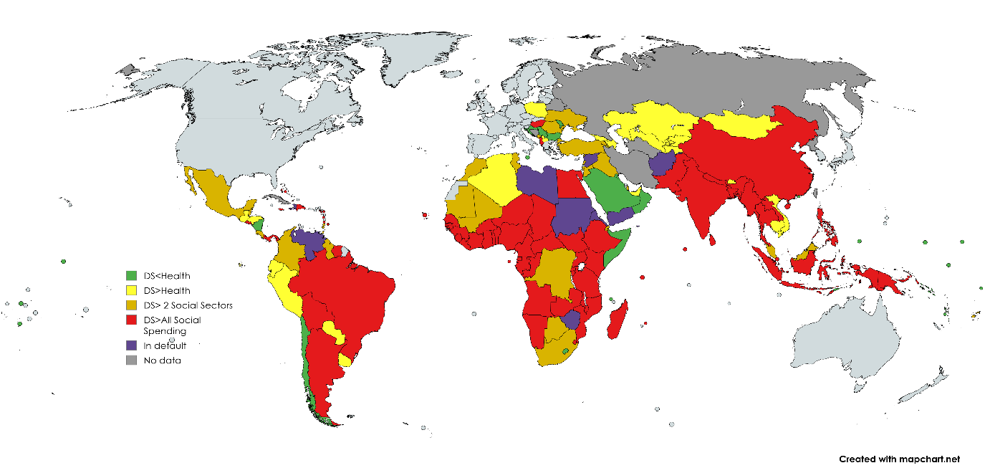
COUNTRIES/PEOPLE AFFECTED
Map shows in red countries where debt service is more than ALL social spending – this is happening in 70 countries
6.3 billion people (97% of South population) have governments spending more on debt > health, 5.9 billion > education or social protection spending, 5.1 billion debt > total social + environmental/climate spending

Slide 8
SUMMARY INDICATORS FOR KEY GROUPS OF COUNTRIES
Country Group | Amount Paid | % of Revenue | % of Spending | % of GDP
All G77&China | US$8.8 trillion | 46.3% | 35.4% | 8.8%
Lower-income Countries* | US$1.3 trillion | 53.8% | 40.9% | 9.4%
Sub-Saharan Africa | US$235 billion | 59.9% | 44.7% | 10.2%
Sida countries¹ | US$151 billion | 46.2% | 36.2% | 8.1%
* = Low-income countries and lower middle-income countries.
Source: Debt Watch Database, Development Finance International, based on IMF data

Slide 9
WHAT CAUSED THE NEW CRISIS ?
IT’S A SHARED RESPONSIBILITY
The crisis is not only due to corruption /poor use of funds by borrowing countries. It is also due to irresponsible lending and corruption by creditors.
Primarily it is because countries went to financial markets to borrow. There is a 70% correlation between countries going to markets and high service, & 86% for “new” (post-2010) or “frontier” borrowers, compared to only 46% for high-corruption countries
This is a joint responsibility: North told South in 2015 that aid would fall so they should go to markets to fund SDGs, + paid for credit ratings/bond advisors
And it is a crisis affecting South & North, which means the system is wrong for everyone.

Slide 10
CURRENT PROPOSALS TO SOLVE THE CRISIS

Slide 11
MORE AMBITIOUS RECENT PROPOSALS
Three main types of proposals being made:
For worst affected poorer countries: restructure debt service to cut it to 10% of budget revenue (HIPC target) Rather than cancel all debt, which cost a huge amount in HIPC/MDRI, give countries 10-year debt service holiday to allow them to finance SDGs and fight climate, nature and inequality crises (DFI, Jubilee Commission, ONE campaign, Africa Ministers)
For countries regularly affected by climate disasters: cut debt service to 10% of revenue for at least 5 years after a disaster hits, to allow them to rebuild and recover without having to borrow even more money (DFI, ODI)
For wealthier countries which fund most of their budgets by market borrowing: dramatically enhance measures to reduce costs of borrowing by half, to levels similar to those paid by the World Bank (UNSG, G20 Africa Experts, MDBs)

Slide 12
WHAT COULD THESE ACHIEVE ?
If just applied mechanically to all countries, could reduce debt service by US$3.4 trillion every year for the next 5 years (SDG financing gap is US$3.5-4 trillion) !
But this wont happen. Excluding countries w sustainable debts and v.low borrowing costs, and high-income countries unless disaster-hit, the total amounts saved = US$910 bn pa
In addition, creditors will set narrow definition of eligible countries, + debtors won’t want relief: overall savings likely to be <US$100 billion a year
Much more vital, at country level, on average the amounts saved would allow poorer Southern countries to DOUBLE their spending on all social and environmental sectors;
It would allow these countries to provide free universal basic education, health care, and universal social protection, and fill the financing gaps for SDGs 1, 3,4,10,13,14 and 15

Slide 13
WHY SHOULD SWEDEN CARE AND WHAT CAN IT DO ?

Slide 14
WHY SHOULD SWEDEN CARE ?
Poor countries don’t owe debt to Sweden. Earlier debt was cancelled, and Sweden has provided only grants since then
Because this is a matter of “climate justice”: poor countries did not create the climate crisis and are now hit by it without remotely enough money to protect themselves, due to debt
Because otherwise we can’t remotely fight the crises of extreme inequality/poverty, or those of climate and nature
Because we shouldn’t undermine Sweden’s other aid:
  aid (esp. via multilaterals) is increasingly used to help repay debt > funding the things (food, water, health, education) Sweden is aiding;
  the tax revenue Sweden is helping countries to collect is being diverted to pay debt.
  This is needed for all countries Sweden helps, including Ukraine
Because we are “interdependent” as global citizens: the poorer/more climate hit a country, the less it can buy our exports and the more it will send us refugees

Slide 15
WHAT MORE COULD SWEDEN DO ?
Current and past Swedish governments have recognised these issues and led push for HIPC/MDRI debt relief.
Very active role in UN Financing for Development summits since 2002, and joined other Nordics in raising issue with/at G7 & G20 conferences (even when geopolitical splits)
But can still do more on its own or as part of “coalitions of the willing” (more details in discussion afterwards). 4 priorities:
Fund programme to build Southern governments’ accountability + transparency to citizens/parliaments (+l anti-corruption/resp. borrowing)
Help countries to reduce own borrowing costs and maximise debt relief, by funding UNCTAD Borrowers’ Platform
Provide broader funding for “debt ecosystem” (thinktanks, researchers, civil society) as did v. successfully for tax post-2015, to beef up analytical/advocacy capacity and get long-term change
Join coalitions of willing under UK G20 Presidency in 2027 and in following-up UN FFD agreement, to accelerate movement to more fundamental measures to reduce country debt service burdens

